Slide 1
Chapter 9 Advanced Architecture

Slide 2
Contents:
RISC and CISC Fundamentals
Instruction Pipeline, Register Windows and Renaming
Flynn’s Taxonomy
MIMD System topologies and architectures
Introduction to Multicore architecture

Slide 3
9.1 RISC and CISC Fundamentals

Slide 4
RISC
RISC stands for Reduced Instruction Set Computer Processor, a microprocessor architecture with a simple collection and highly customized set of instructions.
It is built to minimize the instruction execution time by optimizing and limiting the number of instructions.
It means each instruction cycle requires only one clock cycle, and each cycle contains three parameters: fetch, decode and execute.
The RISC processor is also used to perform various complex instructions by combining them into simpler ones.
RISC chips require several transistors, making it cheaper to design and reduce the execution time for instruction.
Examples of RISC processors are SUN's SPARC, PowerPC, Microchip PIC processors, RISC-V.

Slide 5
Features of RISC
One cycle execution time: For executing each instruction in a computer, the RISC processors require one CPI (Clock per cycle). And each CPI includes the fetch, decode and execute method applied in computer instruction.
Pipelining technique: The pipelining technique is used in the RISC processors to execute multiple parts or stages of instructions to perform more efficiently.
A large number of registers: RISC processors are optimized with multiple registers that can be used to store instruction and quickly respond to the computer and minimize interaction with computer memory.
It supports a simple addressing mode and fixed length of instruction for executing the pipeline.
It uses LOAD and STORE instruction to access the memory location.
Simple and limited instruction reduces the execution time of a process in a RISC.

Slide 6
Advantages Disadvantages
The RISC processor's performance is better due to the simple and limited number of the instruction set.
It requires several transistors that make it cheaper to design.
RISC allows the instruction to use free space on a microprocessor because of its simplicity.
RISC processor is simpler than a CISC processor because of its simple and quick design, and it can complete its work in one clock cycle.
The RISC processor's performance may vary according to the code executed because subsequent instructions may depend on the previous instruction for their execution in a cycle.
Programmers and compilers often use complex instructions.
RISC processors require very fast memory to save various instructions that require a large collection of cache memory to respond to the instruction in a short time.

Slide 7
CISC
The CISC Stands for Complex Instruction Set Computer, developed by the Intel.
It has a large collection of complex instructions that range from simple to very complex and specialized in the assembly language level, which takes a long time to execute the instructions.
So, CISC approaches reducing the number of instruction on each program and ignoring the number of cycles per instruction.
It emphasizes to build complex instructions directly in the hardware because the hardware is always faster than software.
However, CISC chips are relatively slower as compared to RISC chips but use little instruction than RISC.
Examples of CISC processors are VAX, AMD, Intel x86 and the System/360.

Slide 8
Features of CISC
Complex instruction, hence complex instruction decoding.
Instructions are larger than one-word size.
Instruction may take more than a single clock cycle to get executed.
Less number of general-purpose registers as operations get performed in memory itself.
Complex Addressing Modes.
More Data types.

Slide 9
Advantages Disadvantages
The compiler requires little effort to translate high-level programs or statement languages into assembly or machine language in CISC processors.
The code length is quite short, which minimizes the memory requirement.
To store the instruction on each CISC, it requires very less RAM.
Execution of a single instruction requires several low-level tasks.
CISC creates a process to manage power usage that adjusts clock speed and voltage.
It uses fewer instructions set to perform the same instruction as the RISC.
CISC chips are slower than RSIC chips to execute per instruction cycle on each program.
The performance of the machine decreases due to the slowness of the clock speed.
Executing the pipeline in the CISC processor makes it complicated to use.
The CISC chips require more transistors as compared to RISC design.
In CISC it uses only 20% of existing instructions in a programming event.

Slide 10
RISC Vs CISC
RISC | CISC
Focus on software | Focus on hardware
Uses only Hardwired control unit | Uses both hardwired and microprogrammed control unit
Transistors are used for more registers | Transistors are used for storing complex Instructions
Fixed sized instructions | Variable sized instructions
Can perform only Register to Register Arithmetic operations | Can perform REG to REG or REG to MEM or MEM to MEM
Requires more number of registers | Requires less number of registers
Code size is large | Code size is small
An instruction executed in a single clock cycle | Instruction takes more than one clock cycle
An instruction fit in one word | Instructions are larger than the size of one word

Slide 11
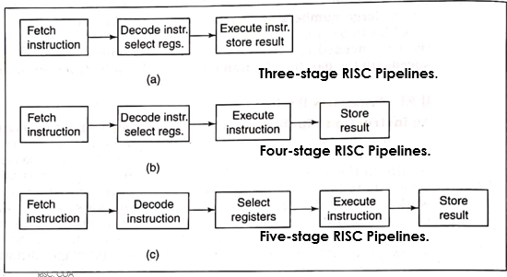
9.2 Instruction Pipeline
A pipeline is like an assembly line in which many products are being worked on simultaneously, each at a different station.
In RISC processors, one instruction is executed while the next is being decoded and its operands are being loaded, while the following instruction is being fetched.
By overlapping these operations, the CPU executes one instruction per clock cycle, even though each instruction requires three cycles to be fetched, decoded, and executed.

Slide 12
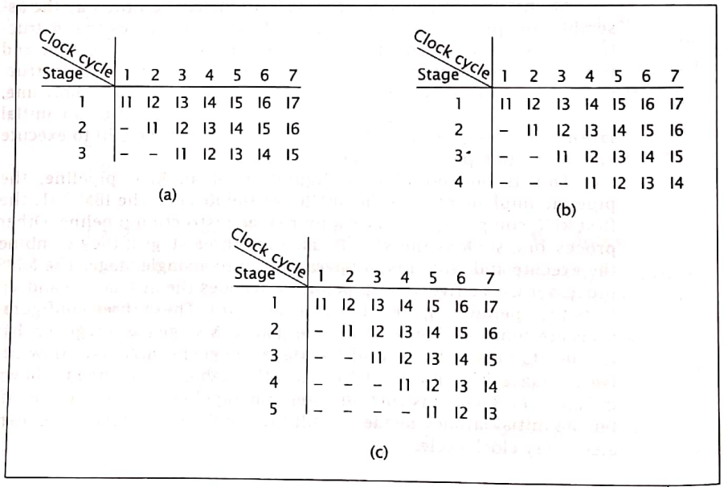
Instruction Pipeline
Figure: Data flow through Three, Four, and Five stage RISC pipelines

Slide 13
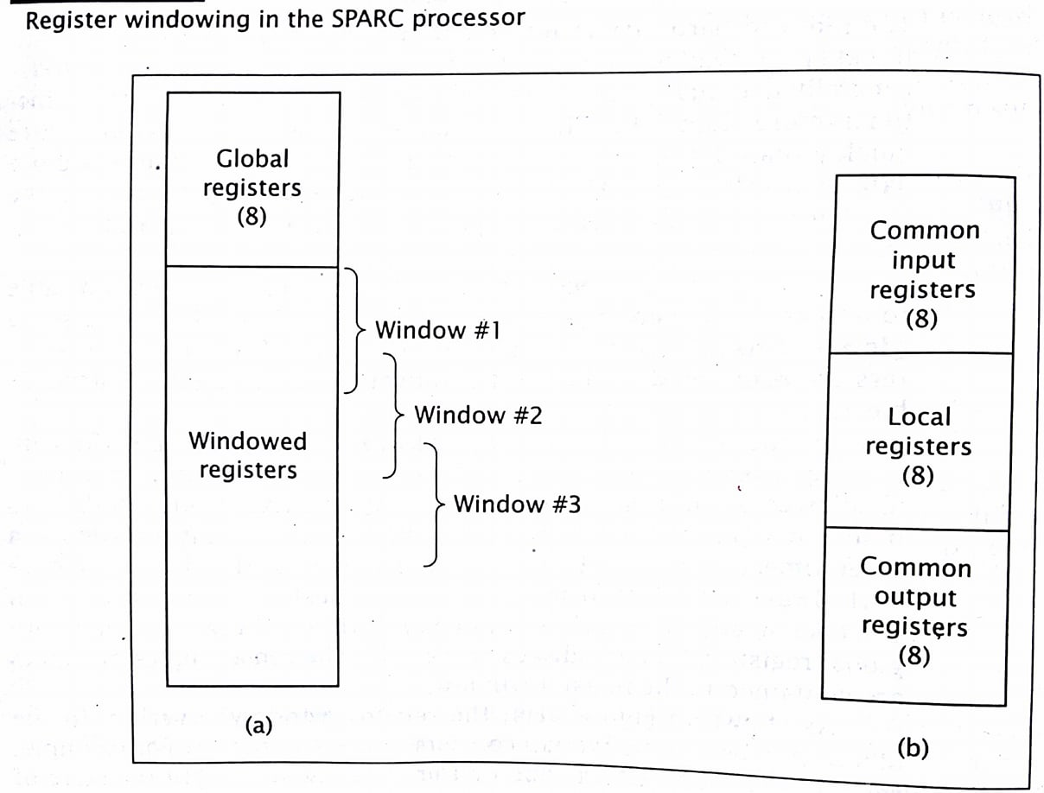
9.3 Register Windowing
To store more content in the CPU, we need registers in the CPU.
But RISC CPU has limited no. of registers.
So, all the registers cannot be accessed at once. Otherwise, it would be like accessing the memory as in CISC.
RISC has following types of registers:
Global registers
Local registers.
Input Shared registers
Output Shared registers
Register window comes in RISC.
It consists of the above last three registers.
The size of Input shared register and the output shared register should be same.
Shared registers
SPARC: Scalable Processor Architecture

Slide 14
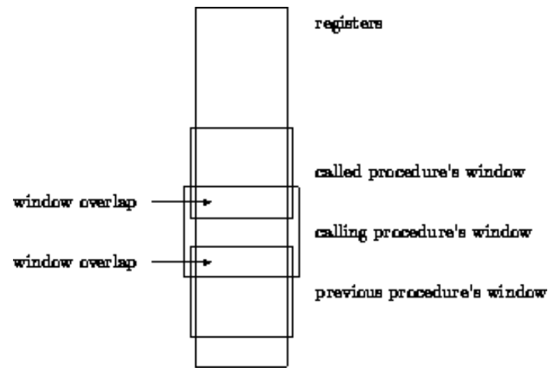
Register Windowing (Contd.)
The reduced hardware requirement of RISC processor leave additional space available on the chip for the system designer.
RISC CPU generally use this space to include a large number of registers, sometimes more than 100.
The CPU can access data in register more quickly than data in memory.
Although, a RISC processor has many register, it may not be able to access all of them at any time.
Most RISC CPU has some global register which are always accessible.
The remaining register are windowed such that only a subset of the registers are accessible at any specific time.
Figure: Overlapping register windows

Slide 15
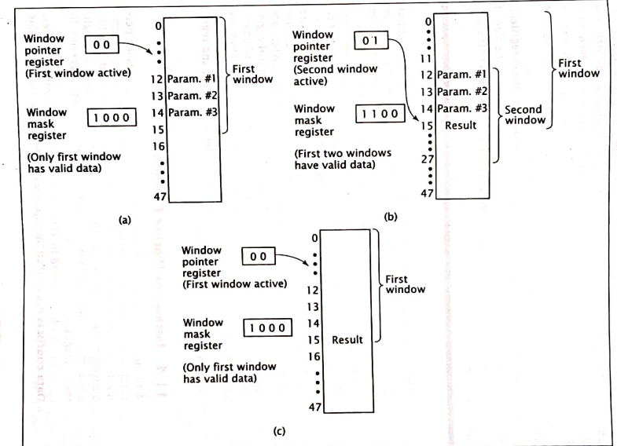
Register Windowing (Contd.)
Consider a CPU with 48 registers.
The CPU has four windows with 16 registers each,
and overlap of four registers between windows.
These are shared registers.
Initially, the CPU is running a program using its first register window.
It must call a subroutine and pass three parameters to it.
The CPU stores these parameters in three of the four overlapping registers and calls subroutine.
The subroutine can directly access these parameters.
Subroutine calculates a result, stores the value in one of the overlapping registers, and returns to the main program.
This deactivates the second window; the CPU now works with the first window and can directly access the result.

Slide 16

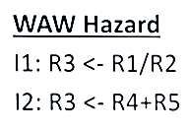
Register Renaming
Register renaming is a standard approach for eliminating false data dependencies, such as WAR and WAW dependencies, between register data.
Case of WAW
If, may be because of the operator used (here / and + ), the I2 might be executed before I1.
Here, first R3 is written with I2, and then again R3 is written with I1. So, new value of R3 is actually overwritten by I1.
This causes WAW hazard.
Solution: Register Renaming
Store the result of I2 in a temporary register T2
Store the result of I1 in another temporary register T1.
Thus, solved.
Temporary registers
T1
T2
R3
R3
Reference: https://www.youtube.com/watch?v=3NieJAgkYiw

Slide 17

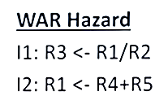
Register Renaming
Case of WAW
If, may be because of the operator used (here / and +), the I2 might be executed before I1.
Here, first R1 is written with I2, and then again R3 is written with I1. But, new value of R1 is actually taken here. This was not supposed to be.
This causes WAW hazard.
Solution: Register Renaming
Store the result of I2 in a temporary register T4
Store the result of I1 in another temporary register T3.
Thus, solved.
Temporary registers
T3
T4
R3
R1
Reference: https://www.youtube.com/watch?v=3NieJAgkYiw

Slide 18
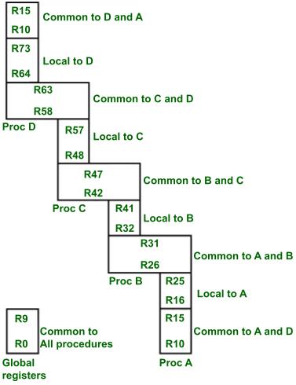
9.4 Register Organization in RISC CPU
Window D
In this organization, the RISC CPU contains 74 registers.
Registers R0 to R9 are global registers that contain parameters which are common to all procedures.
The remaining registers(R10 to R73) are divided into four windows to contain procedures A, B, C and D.
Each window contains 10 local registers and two sets of 6 registers common to consecutive windows.
Local registers contain local variables and common overlapped registers help to pass parameters between adjacent procedures without actual movement of data.
One of the register window is activated at a time. The high registers of the calling procedure overlap the low registers of the called procedures, therefore parameters are passed from calling to called procedure easily.
Window C
Window B
Window A
Figure: Overlapped register window of RISC CPU

Slide 19
9.4 Register Organization in RISC CPU (Contd.)
Window D
The organization of register windows has the relationship as
Number of global registers = G
Number of local registers present in each window = L
Number of registers common to two adjacent windows = C
Number of windows = W
Then the number of registers available for each window is calculated by :
Window size (S)= L+2C
The total number of registers required in the processor is
Register File = (L+C)W + G
Here:
In the above figure we have: G= 10, L= 10, C= 6, w= 4, then
the window size = 10+2×6 = 22
register file size = (10+6)×4 + 10 = 74
Window C
Window B
Window A

Slide 20
Numerical:
In a system, there are 8 windows of registers, each register share 8 input registers, and 8 output registers. Each of the windows has 4 local registers. The system has 10 global registers. Calculate the total number of registers in the system. Show the pictorial representation as well. [PU 2018 Spring]
Draw figure here as in the previous slide
Here:
Number of global registers ( G) =10
Number of local registers present in each window (L)= 4
Number of registers common to two adjacent windows (C) = 8 (here common input and output register is 8)
Number of windows (W)= 8
We have:
Window size (S)= L+2C =4+2*8 =20
The total number of registers required in the processor is = (L+C)W + G =(4+8) *8+10= 106
Reference: https://www.youtube.com/watch?v=GPIgi-OIe_g

Slide 21
Assignment:
In a RISC processor system, there are 10 global registers and 8 register windows, each having 4 common input registers, 10 local registers, and 4 common output registers. How many registers are in this CPU? Also show the diagrammatic representation.
Reference: https://www.youtube.com/watch?v=GPIgi-OIe_g

Slide 22
9.5 Organization of Multiprocessor System
Characteristics of Multiprocessor
Flynn’s Classification
System topologies
MIMD system architectures

Slide 23
a) Characteristics of multiprocessor:
A multiprocessor system is controlled by one operating system that provides interaction between processor and all component of system.
VLSI technology has reduced cost of multiple processor system.
Multiprocessing improves reliability of the system so that a failure or error in one part has less effect on rest of system.
Multiprocessor improves performance by decomposing a program into parallel executable tasks.
Multiprocessor are classified by the way their memory organized.
A multiprocessor with common shared memory is shared memory multiprocessor.
A multiprocessor that has its own private local memory is distributed memory multiprocessor.

Slide 24
b) Flynn’s Classification
Flynn's classification divides computers into four major groups based on instruction and data processing.
A computer is classified by
whether it processes a single instruction at a time or multiple instructions simultaneously, and
whether it operates on one or multiple data sets.
i. | SISD | Single Instruction with Single Data
ii. | SIMD | Single Instruction with Multiple Data
iii. | MISD | Multiple Instruction with Single Data
iv. | MIMD | Multiple Instruction with Multiple Data

Slide 25
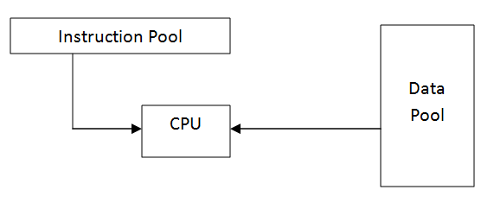
i) SISD
Single Instruction with Single Data
Represents the organization of a single computer containing a control unit, a processor unit, and a memory unit.
Instructions are executed sequentially and the system may or may not have internal parallel processing capabilities.
Parallel processing may be achieved by means of multiple functional units or by pipeline processing.

Slide 26
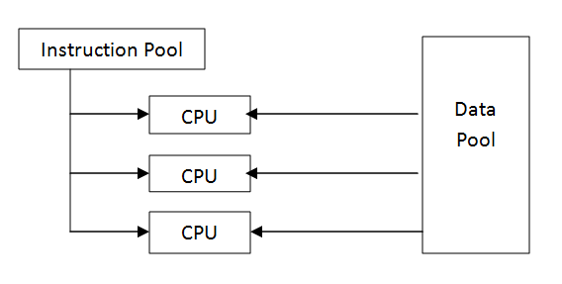
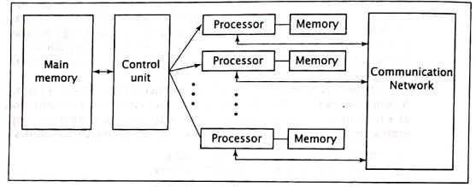
ii) SIMD
Single Instruction with Multiple Data
Represents an organization that includes many processing units under the supervision of a common control unit.
All processors receive the same instruction from the control unit but operate on different items of data.
The shared memory unit must contain multiple modules so that it can communicate with all the processors simultaneously.
Since there is only one instruction, each processor does not have to fetch and decode each instruction.
Figure: A generic SIMD organization

Slide 27
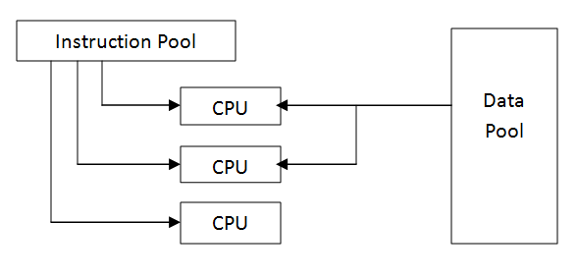
iii) MISD
Multiple Instruction with Single Data
Multiple instructions operate on a single data stream.
This classification is not practical to implement.
So, no significant MISD computers ever been built. It is used for fault tolerance.

Slide 28
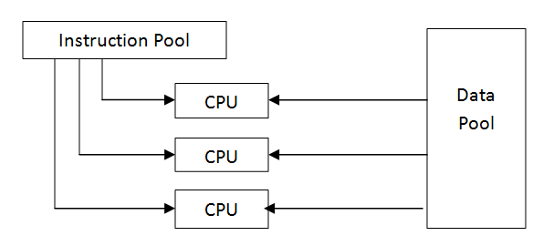
iv) MIMD
Multiple Instruction with Multiple Data
Systems referred to as multiprocessors or multi-computers are usually MIMD.
It may execute multiple instructions simultaneously unlike SIMD.
So, each processor must include its own control unit.
MIMD machines are well suited for general purpose use.

Slide 29
C) System Topologies
It refers to the various ways of connection of processor. MIMD system topologies
Shared bus Topology
Ring Topology
Tree Topology
Mesh Topology
Hyper cube Topology
Completely connected Topology

Slide 30
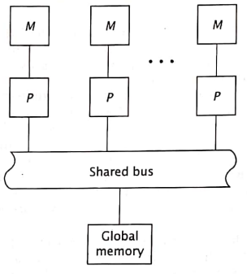
a) Shared Bus Topology
Simplest topology
A processor communicates with each other exclusively via the bus.
This bus can handle only one data transmission at a time. This is controlled by bus arbitration.
If more processors are added, then demand of bus will be high resulting in delays.
Shared bus systems are easy to expand.

Slide 31
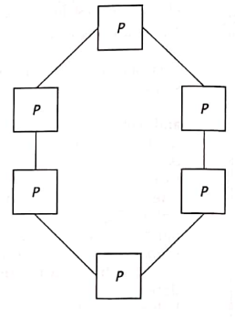
b) Ring topology
Uses direct dedicated connections between processors.
No need of a shared bus.
However, a piece of data may have to travel through several processors to reach its final destination.

Slide 32
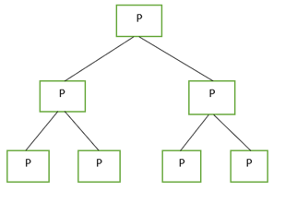
c) Tree topology
All processors must have two communication links.
It uses direct connection between processors.
There is only one unique path between any pair of processors.

Slide 33
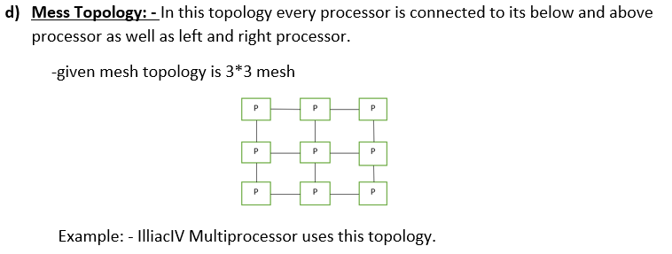

Slide 34
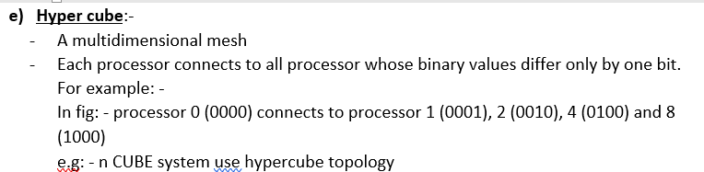
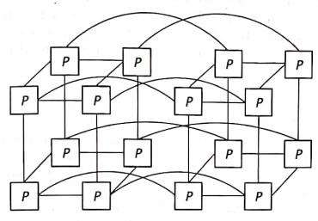

Slide 35
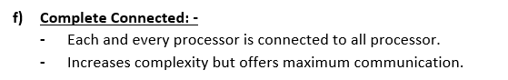
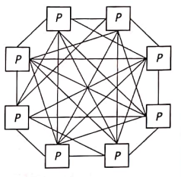

Slide 36
9.6 MIMD System Architecture:
It refers to its connections with respect to system memory.
Symmetric multiprocessor (SMP)
A computer system that has two or more processors with comparable capabilities.
All processors must be capable of performing the same functions, this is the symmetry of SMPs.
An integrated OS controls entire computer system.
All processor has access to same I/O devices and memory modules.
Types of SMP:
UMA (Uniform Memory Access)
NUMA (Non Uniform Memory Access)

Slide 37
Shared Memory model of MIMD
UMA (Uniform Memory Access)
NUMA (Non Uniform Memory Access)
COMA

Slide 38
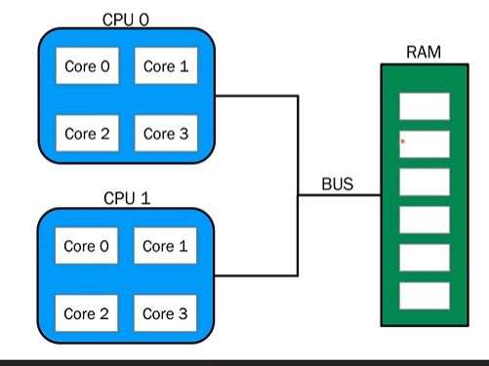
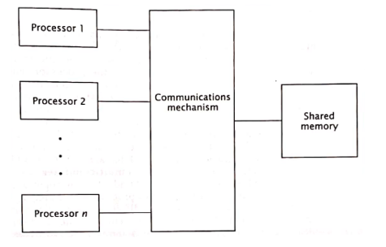
i) UMA (Uniform Memory Access) Architecture
This architecture has a single shared memory.
It gives all CPU equal access to all locations in shared memory.
They interact with shared memory through some common mechanism.

Slide 39
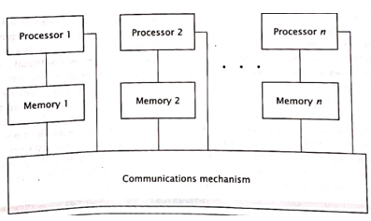
ii) NUMA
Non-Uniform Memory Access architecture
It does not allow uniform access to all shared memory locations
This architecture still allows all processors to memory module closest to it, i.e. its local shared memory, more quickly than other. Hence, memory access time are non-uniform.
Every memory module has a different address range.
NUMA computer may not be SMP.
NUMA has better performance and scalability than UMA.
Eg: CRAY T3E supercomputer
Cache-coherent NUMA
CC-NUMA is similar to the NUMA architecture, except each processor includes cache memory.
The cache can buffer data from memory modules that are not local to the processor, thus reducing the access time of the most lengthy memory transfers.
However, CC-NUMA introduces cache coherence problem.
Reference: https://www.youtube.com/watch?v=gCOEunP5kjs
https://www.youtube.com/watch?v=vXcMGqFng-o

Slide 40
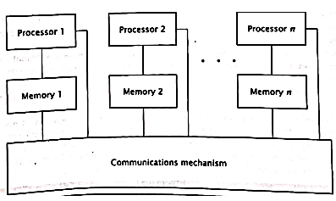
Cache-coherent NUMA
CC-NUMA is similar to the NUMA architecture, except each processor includes cache memory.
The cache can buffer data from memory modules that are not local to the processor, thus reducing the access time of the most lengthy memory transfers.
However, CC-NUMA introduces cache coherence problem.
Cache
Cache
Cache
Reference: https://www.youtube.com/watch?v=gCOEunP5kjs
https://www.youtube.com/watch?v=vXcMGqFng-o

Slide 41
Assignment:
Differentiate between UMA and NUMA architecture
https://www.geeksforgeeks.org/difference-between-uniform-memory-access-uma-and-non-uniform-memory-access-numa/
https://www.javatpoint.com/uniform-memory-access-vs-non-uniform-memory-access

Slide 42
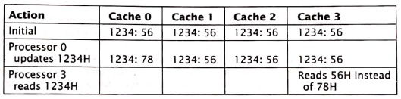
Cache Coherence
It is a problem in multiprocessor system.
Multiprocessor have individual cache for each processor.
This can lead to problem when two or more caches hold the value of same memory location simultaneously.
As one processor stores a value to that location in its cache, the other cache will have an invalid value in its location.
The extra writes to main memory is needed which decreases system performance.
This is cache coherence.
A system with 4 processor, each of which has write-back cache.
Assume all 4 cache have loaded content of shared memory location1234H which is 56H.
Then one of the processors, processor 0 writes value 78H to this location in its cache.
But caches 1,2and 3 do not have correct value.
If one of the other processors reads then it will read the old incorrect value 56H instead of correct value 78H.

Slide 43
iii) COMA architecture
However, CC-NUMA introduces cache coherence problem when two or more caches hold the same piece of data.
When one processor changes the value of this data, the other’s caches’ values are invalid.
A solution to this problem is Cache Only Memory Access (COMA) architecture.
Each processor’s local memory is treated as a cache.
When processor request data that is not in cache local memory), the system loads that data into local memory as part of memory operation.
Eg: KSR1, KSR2, DDM

Slide 44
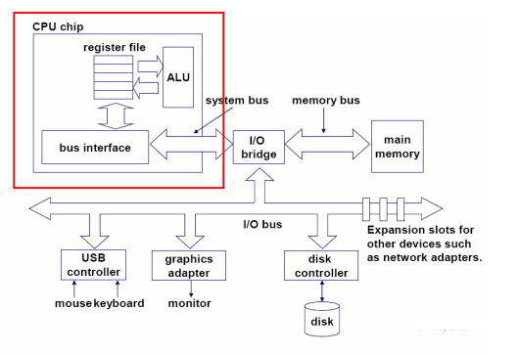
9.7 Introduction to Multicore Architecture
Figure: Single-core CPU chip
Reference: https://www.cs.cmu.edu/~fp/courses/15213-s07/lectures/27-multicore.pdf

Slide 45
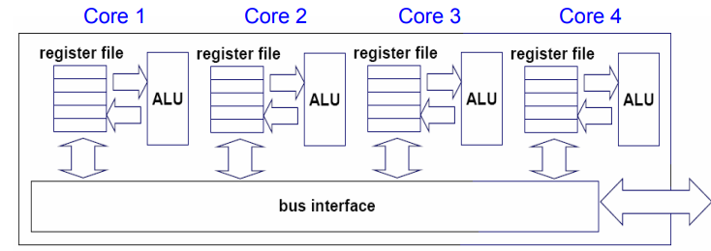
Introduction to Multicore Architecture
Replicate multiprocessor cores on a single die.
Reference: https://www.cs.cmu.edu/~fp/courses/15213-s07/lectures/27-multicore.pdf

Slide 46
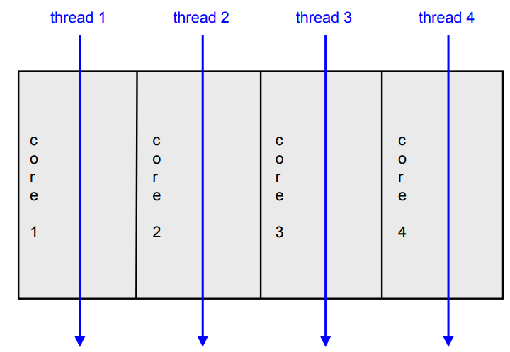
Introduction to Multicore Architecture
The cores fit on a single processor socket.
The core runs in parallel.
Also called CMP (Chip Multi-Processor)
Reference: https://www.cs.cmu.edu/~fp/courses/15213-s07/lectures/27-multicore.pdf

Slide 47
Introduction to Multicore Architecture
Multicore refers to an architecture in which a single physical processor incorporates the core logic of more than one processor.
A single integrated circuit is used to package or hold these processors.
These single integrated circuits are known as a die.
Multicore architecture places multiple processor cores and bundles them as a single physical processor.
The objective is to create a system that can complete more tasks at the same time, thereby gaining better overall system performance.

Slide 48
Assignment:
In a RISC processor system, there are 10 global registers and 8 register windows, each having 4 common input registers, 10 local registers, and 4 common output registers. How many registers are in this CPU? Also show the diagrammatic representation.
Define instruction pipeline. Explain it.
Explain the Flynn’s Taxonomy.
What do you mean by MIMD system architecture? Compare UMA architecture and NUMA architecture.
Explain the multicore architecture of processor.

Slide 49
Exam questions:
What is instruction pipelining? Differentiate between RISC and CISC processors. [PU 2017 Fall]
What is Register Windows? In a system, there are 5 windows of registers, each register share 4 input registers, and 4 output registers. Each of the windows has 10 local registers. The system has 20 global registers. Calculate the total number of registers in the system. Show the pictorial representation as well. [PU 2018 Fall]
What is Register Windows? In a system, there are 8 windows of registers, each register share 8 input registers, and 8 output registers. Each of the windows has 4 local registers. The system has 10 global registers. Calculate the total number of registers in the system. Show the pictorial representation as well. [PU 2018 Spring]
What is Register Windows? In a system, there are 8 windows of registers, each register shares 8 input registers, and 8 output registers. Each of the windows has 4 local registers. The system has 10 global registers. Calculate the total number of registers in the system. Show the pictorial representation as well. [PU 2019 Spring]

Slide 50
Exam questions:
What is cache coherence? Describe how cache coherence can be dealt? List them. Also explain in brief about MESI protocol. [PU 2017 Fall]
How are memory organized in multiprocessor system? Illustrate with suitable diagrams. [PU 2018 Spring]
What is Flynn’s Taxonomy? [PU 2017 Spring]

Slide 51
End of chapter 9

